Slide 1

UMBC Counseling Scheduling System
TEAM REVOLUTION
Shraddha Kapse
Suman Pogul
Rachael Muller
Priya Jain
Prashanthi Sandra Grace
Date Submitted: 12/06/2022

Slide 2
Table of Contents
Introduction
Project Management Plan
Roles & Responsibilities
Milestones
Systems Requirements
System Models
Process Modeling
Data Modeling
Take Away from the Project
References

Slide 3
Introduction
Our application supports Retriever Integrated Health students by assisting them with mental health, emotional, and social concerns that interfere with their academics.
The objective of the project is to plan a self-service scheduling application for students of UMBC.
Current System: Students need to call the counseling center and make an appointment.
Problems Faced:
Limited availability of employees
Prolonged procedure to make an appointment
Less customer satisfaction
A Proposed Solution: Develop a Self-Service Scheduling Application.
The application developed has an user-friendly interface for students to schedule their appointments when it is convenient for them, choose a counselor of their choice, and have their paperwork already completed when they arrive for their first appointment

Slide 4
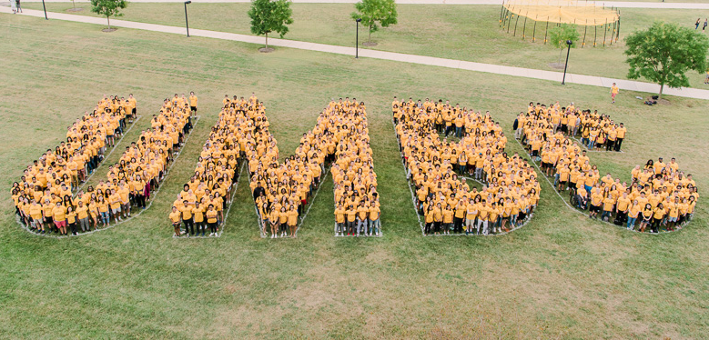
Project Management Plan

Slide 5
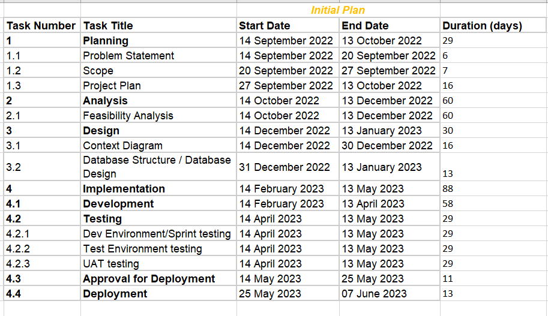
Initial Plan

Slide 6
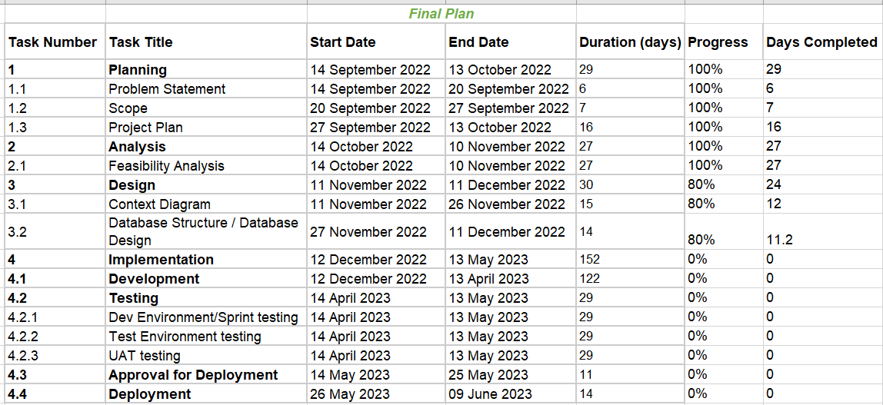
Final Plan

Slide 7
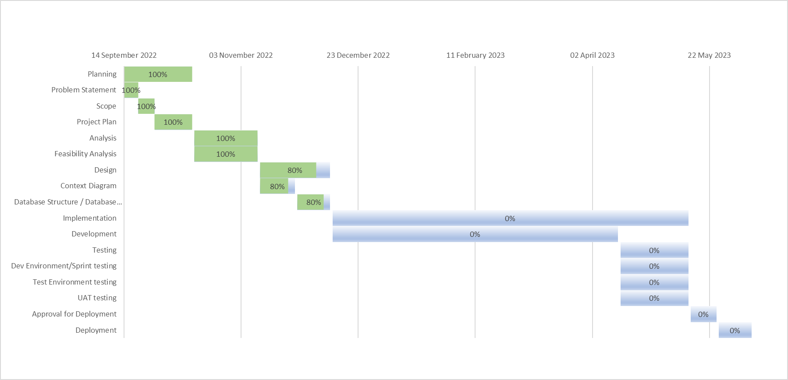
Gantt Chart (Final Plan)

Slide 8
Roles & Responsibilities
Name | Roles | Responsibilities | Contribution
Suman Pogul | Manager | Management Issues, Project Management Plan,Gantt Chart, Development Model, Communication Plan, Alternative Solution, Future Work, Student Survey Data, Entity Relationship Diagram | 20%
Shraddha Kapse | Team Lead | Introduction, System Flow, Student survey data, Development model, Current system snapshots, planning, editing, miscellaneous, Use Case, Sequence, Class Diagram | 20%
Rachael Mueller | Business Analyst | Contacting RIH, Creating User Survey, Conducting supporting research, Creating system diagrams, System Request/ Works Cited, Supporting Documentation, Editing, System Requirements, Milestones | 20%
Priya Jain | Solution Architect | Feasibility Analysis, Project Plan, Table of content, Editing, Planning, Student survey, Development Model, System Architecture Diagram, Data Flow Diagram, UI Design | 20%
Prashanthi Sandra Grace | Developer | System Flow, Diagrams, workflow, scope, Student Survey Data, Entity Relationship Diagram, Supporting Documentation, Project Management Plan, Conclusions | 20%
Overall - 100%

Slide 9
Milestones
Preliminary Wireframes- November 15th
Context Diagram- November 26th
Databases Structure/ Database Design- December 11th
Finalized Wireframes- December 11th
Development- April 13th
Testing- May 13th
Approval for Deployment- May 25th
Deployment- June 9th

Slide 10
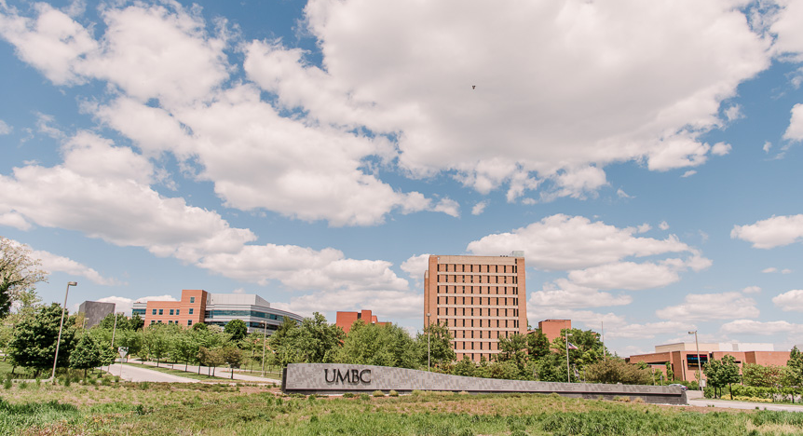
System Requirements

Slide 11
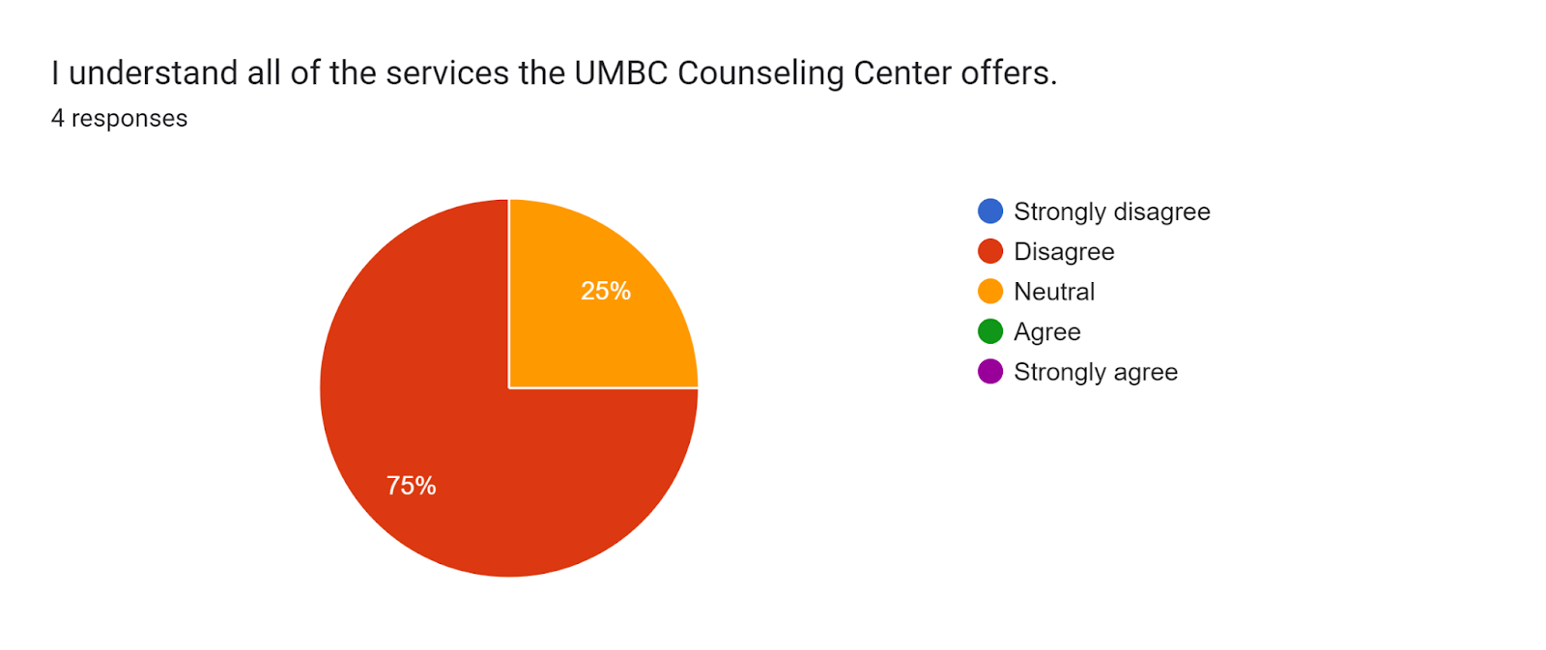
Methods
Viewed forms and pages currently available on web portal
Emailed key Counseling Center staff members
Created a google survey and collected responses from current UMBC students

Slide 12
Functional
The system must allow students to enter essential information into their profile and block calendar access until they do so
The system must allow students to view and select available time slots
The system must communicate to the student in an email that their appointment request is pending verification by a staff member and communicate to the student when their request has been verified
The system must allow the student to opt-in to push notifications reminding them of an upcoming appointment

Slide 13
Non Functional
Operational
Performance
The system must operate with mobile devices (iOS and Android)
The system will read and write to the main Counseling Center appointment database and client database
Always-on network connection permits constant, real time updates
Network transaction response time < 3 seconds
Maximum 1,700 users at a time (13% of 13,062 students rounded)*
99% uptime performance
Notes:
*https://www.aucccd.org/assets/documents/Survey/2019-2020%20Annual%20Report%20FINAL%204-2021.pdf

Slide 14
Non Functional
Security
Cultural/ Political
Client data can only be accessed through a secure portal by Counseling Center staff
Clients can only access their own scheduling data; all other data appears as anonymized “available/ unavailable”
Data will be encrypted from the user to the website
The system will display all dates and times in standard time, (i.e. 1:00 pm on Tuesday, January 10th, 2023)
The client will be required to have an existing myumbc login
All HIPAA privacy disclaimers will be included in the appropriate data entry points
Every login will display a hotline if the student needs immediate help

Slide 15
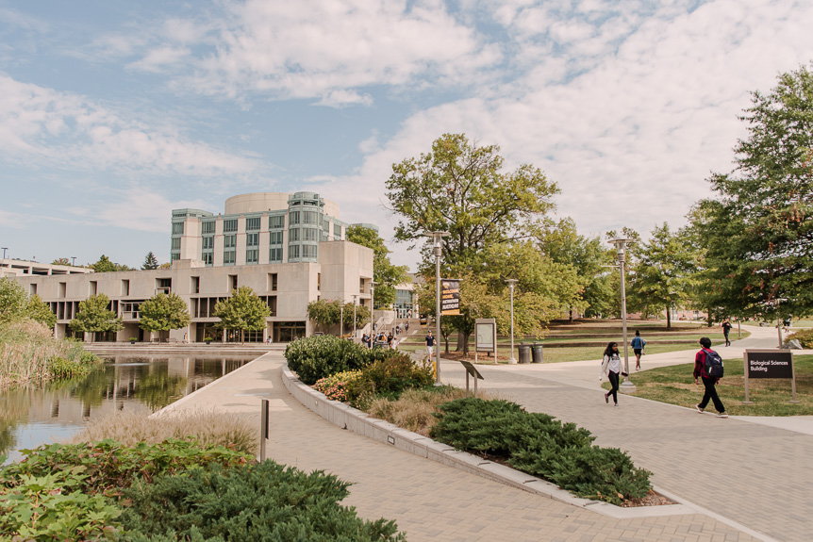
System Models

Slide 16
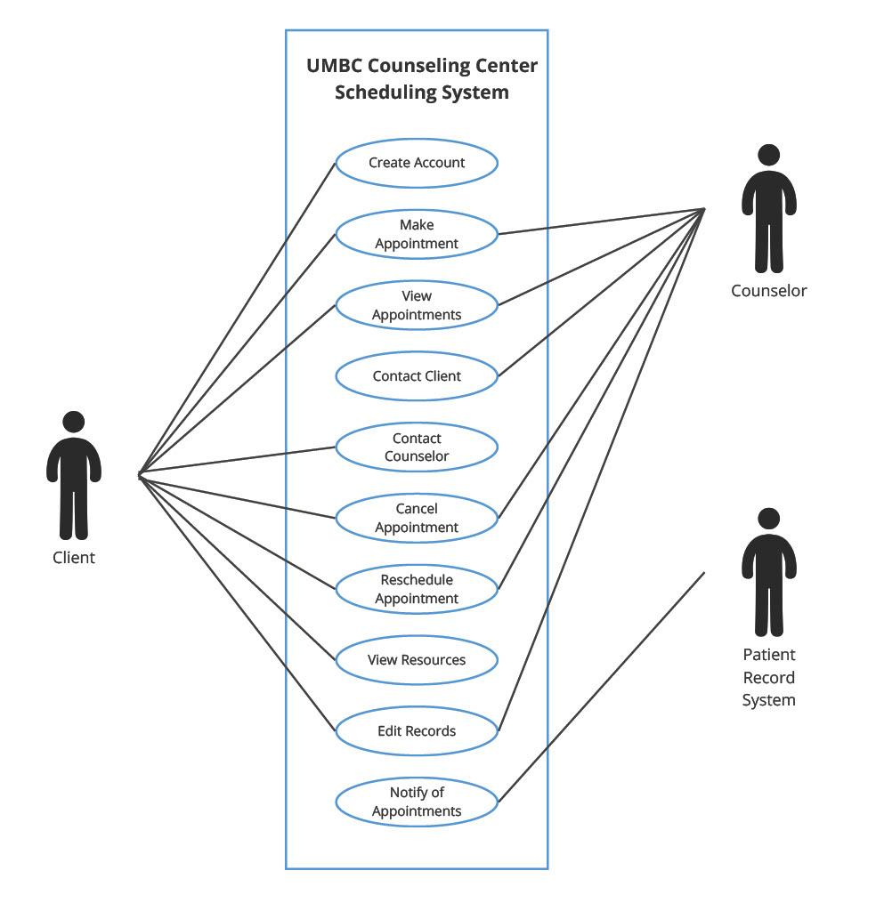
Use case diagram

Slide 17
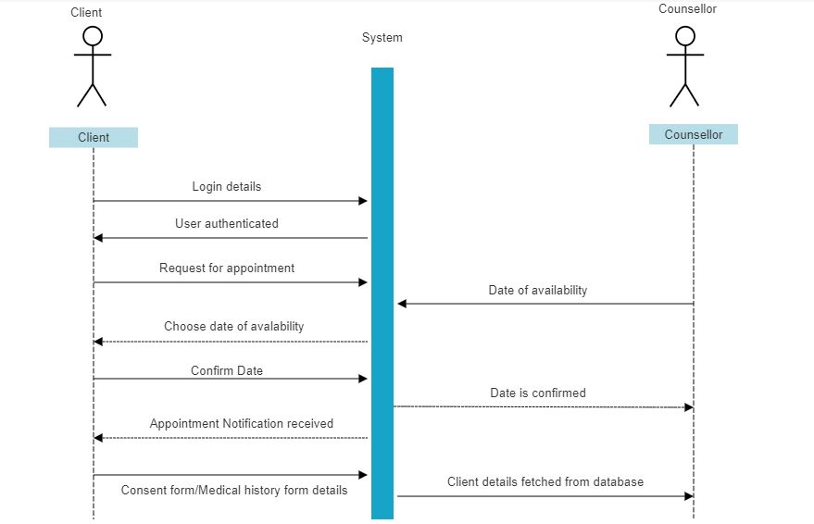
Sequence Diagram

Slide 18
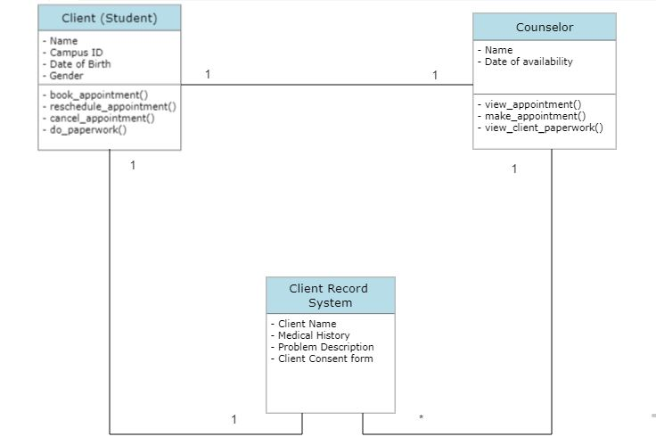
Class Diagram

Slide 19
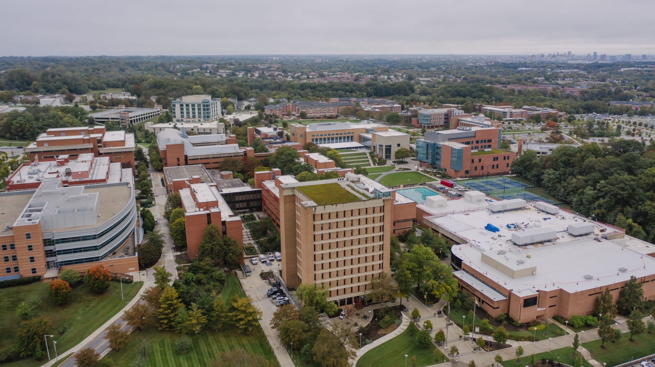
Process Modeling

Slide 20
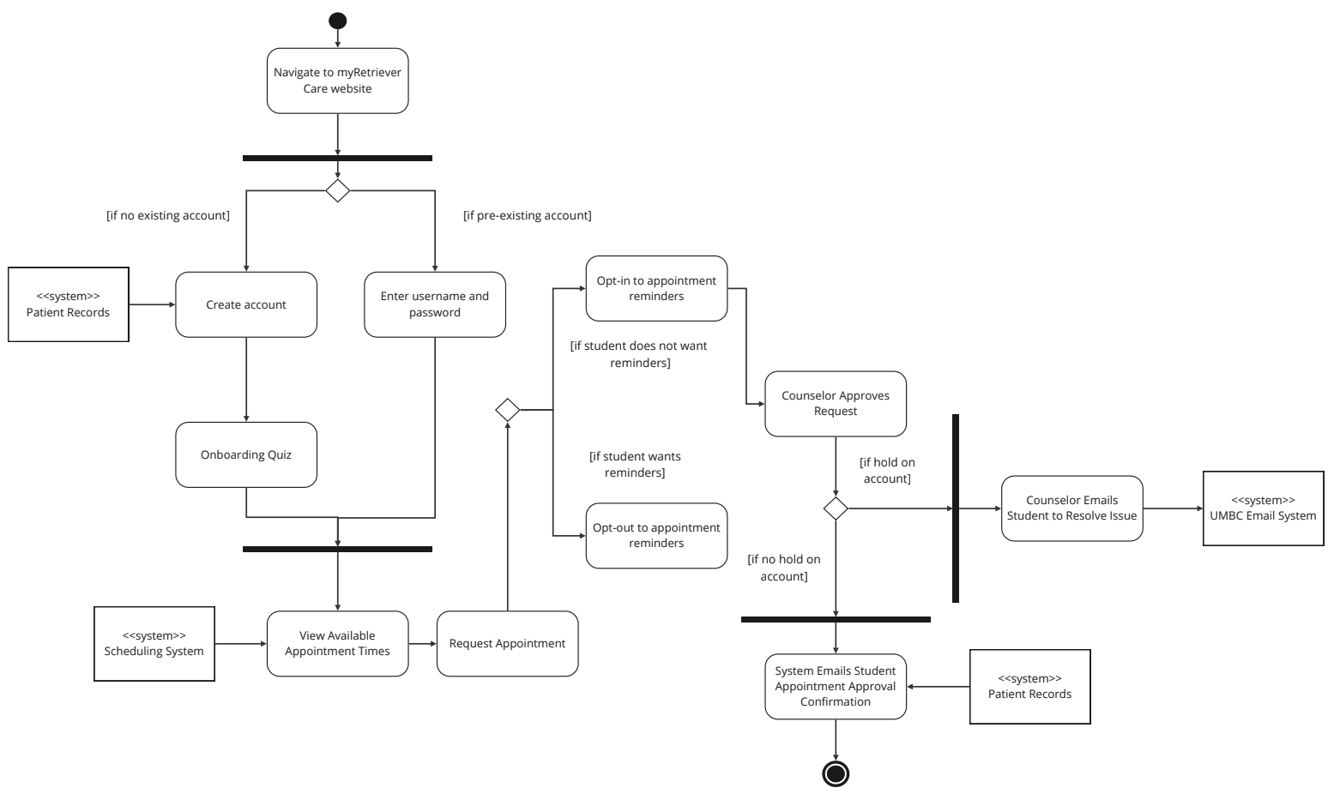
System Architecture

Slide 21
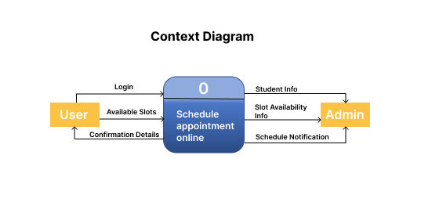
Data Flow Diagram
Context Diagram:
It provides a fundamental overview of the entire system or process under analysis or modeling. The system is displayed as a single, high-level process, together with its relationship to external entities, in what is intended to be an overview view.

Slide 22
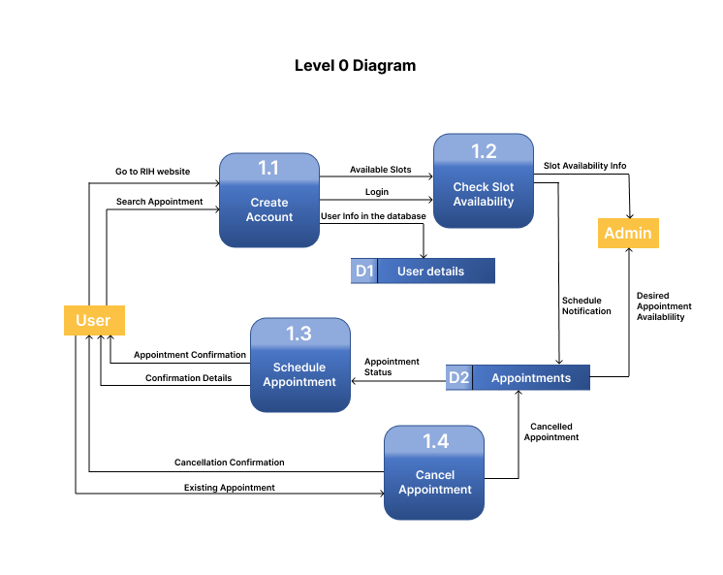
Data Flow Diagram
Level 0 Diagram:
It provides a fundamental the internal process components of all the primary processes that make up the entire system are displayed in this diagram. It also demonstrates how the major processes are connected through data flows, external entities, and the significant processes with which they interact, and it also shows how the data stores add stored data.

Slide 23
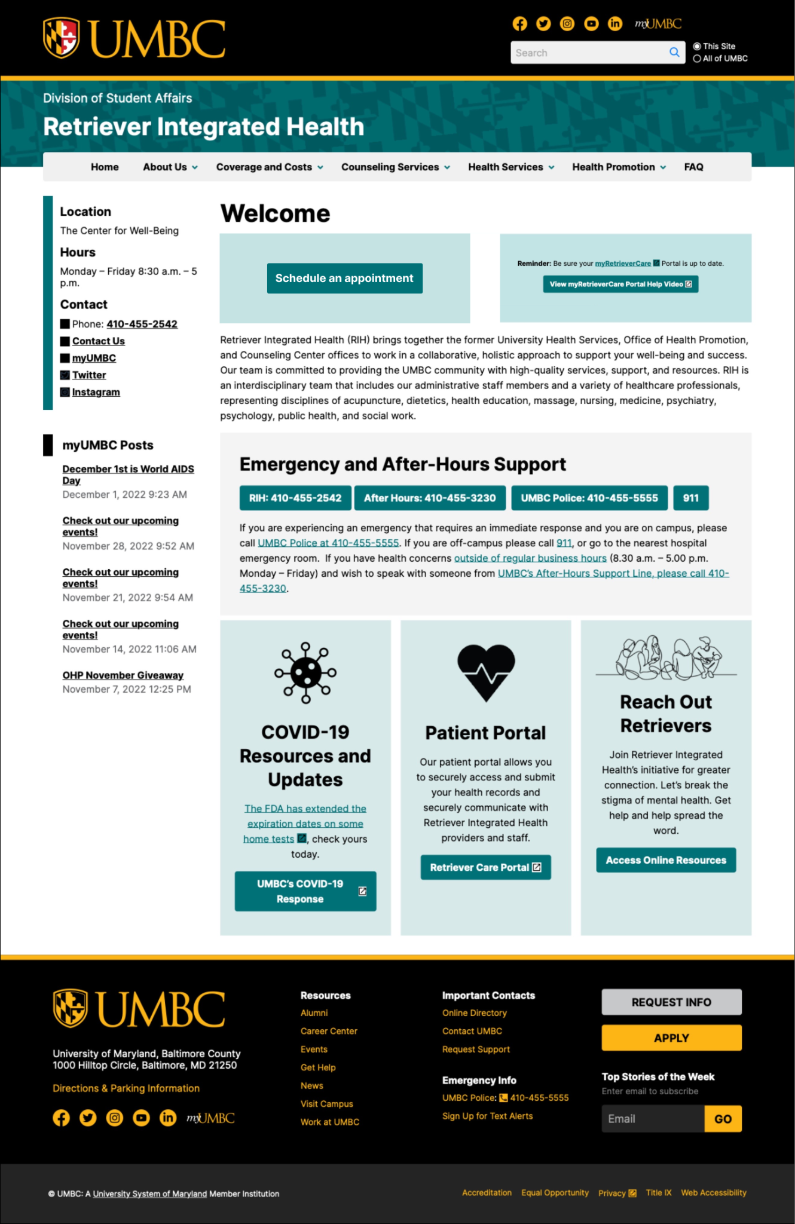
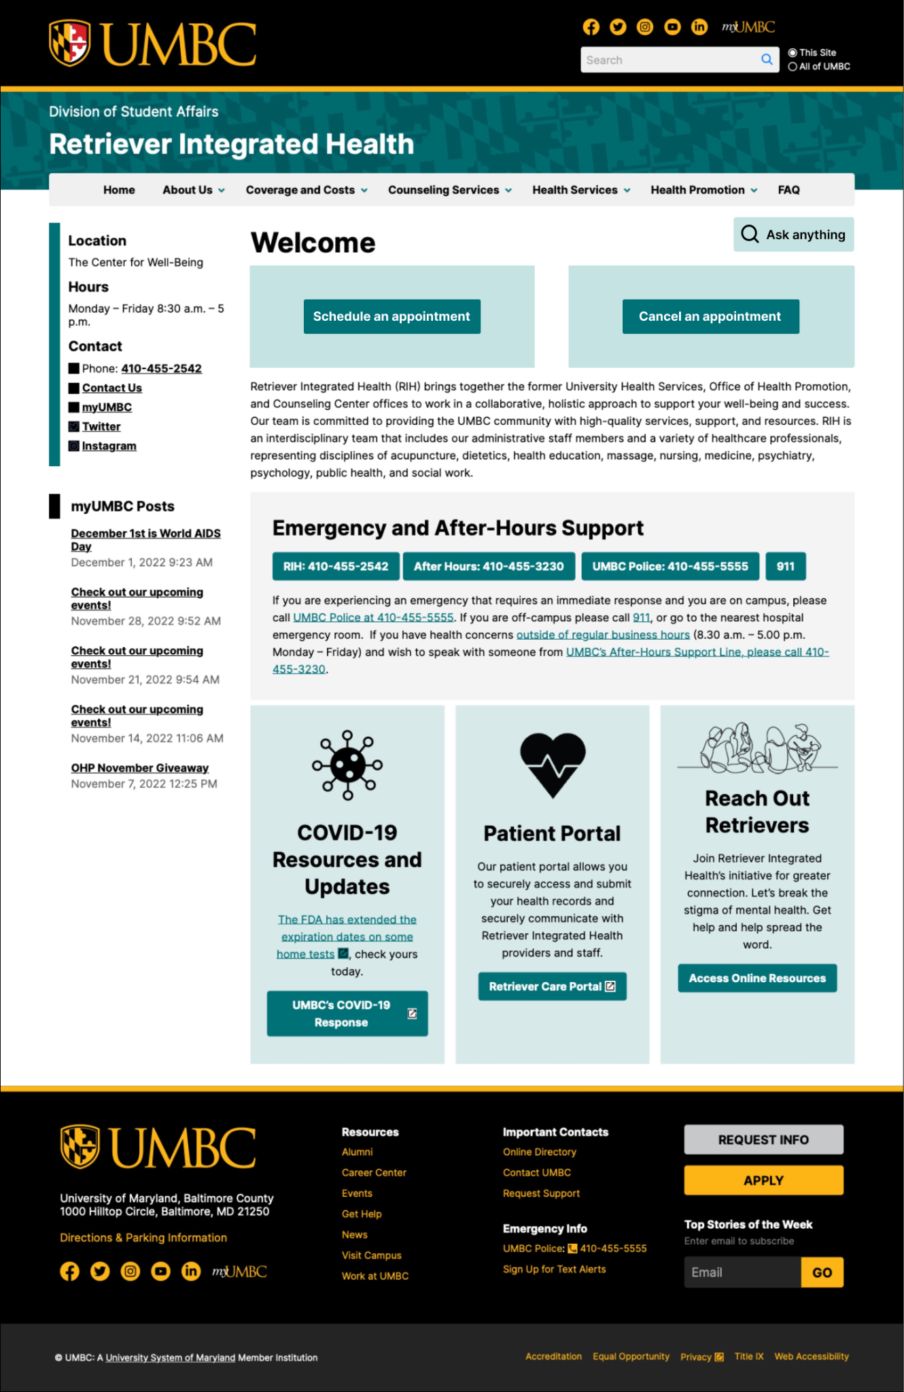
User Interface Design

Slide 24
Data Modeling

Slide 25
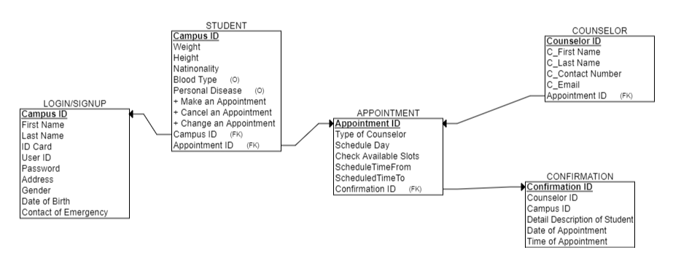
Entity Relationship Diagram

Slide 26

Take away from the Project
As the saying goes, “ If you don’t learn something new from the project, then you are doing something wrong.
A Change to the organization
Team Management & staff planning
Time allotment & management
Gathering and preparing System requirements

Slide 27
References
https://health.umbc.edu/counseling-services/counseling/
https://health.umbc.edu/about-us/staff/
Baker, Sara A. Analysis of the FY 2023 Maryland Executive Budget, 2022. Department of Legislative Services Office of Policy Analysis . Retrieved 4 October 2022, from https://mgaleg.maryland.gov/pubs/budgetfiscal/2023fy-budget-docs-operating-R30B31-University-of-Maryland-Baltimore-County.pdf.
Van De Motter, A., & Allen, A. (2021, April 23). Maryland College students seek mental health help amid covid-19 pandemic. Maryland Matters. Retrieved October 4, 2022, from https://www.marylandmatters.org/2021/04/23/maryland-college-students-seek-mental-health-help-amid-covid-19-pandemic/

Slide 28


Slide 29

Thank you!

